Slide 1
Mantid at ISIS : Current implementation and future plans

Slide 2
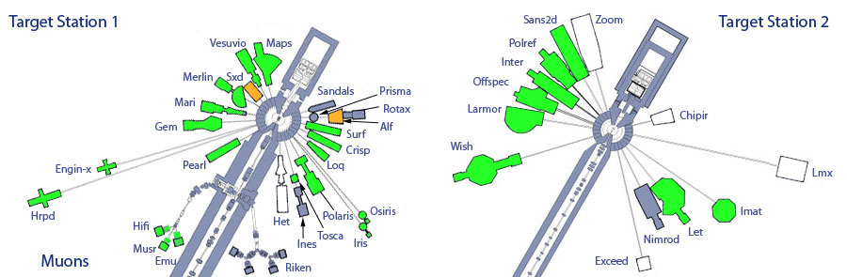
Instrument Usage

Slide 3
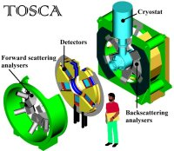
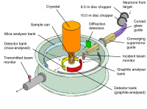
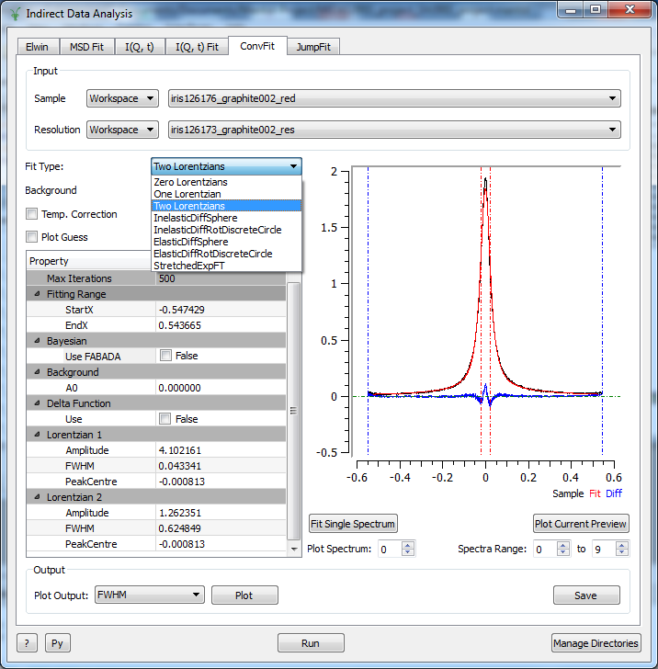
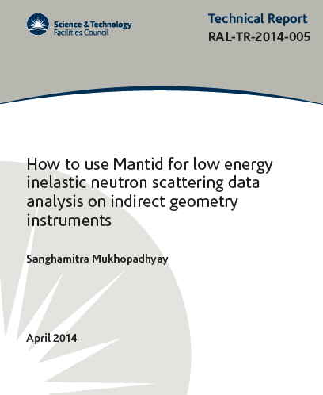
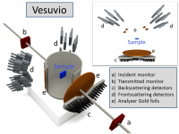
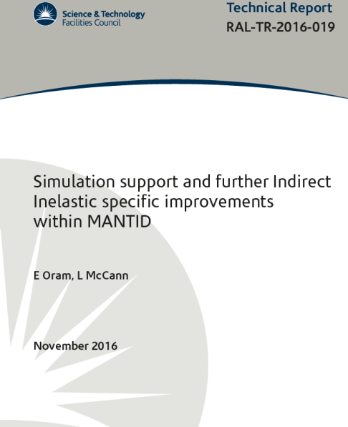
Molecular Spectroscopy Group
Current Status
All instruments
Data Reduction
IRIS
VESUVIO
Data Visualization
IRIS/OSIRIS
TOSCA
Data Analysis
Data Interpretation
OSIRIS
Currently about 500 users using Mantid for data reduction
Half of them using it for analysis
10 Reports/papers are on ePubs on the implementations.
About 130 research papers/theses published in 2016-17 from the group have used Mantid in some form

Slide 4
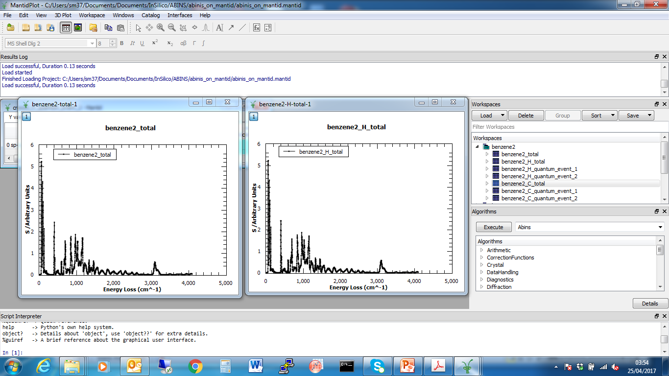
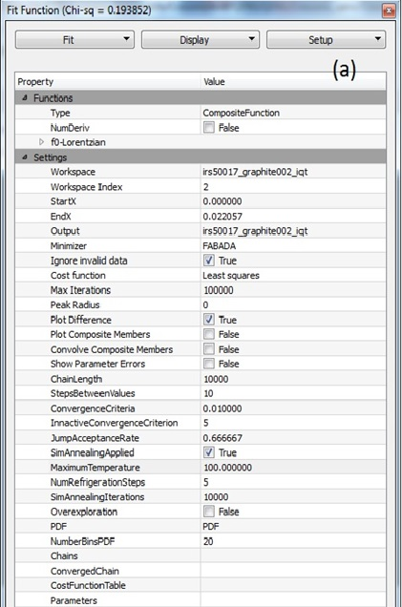
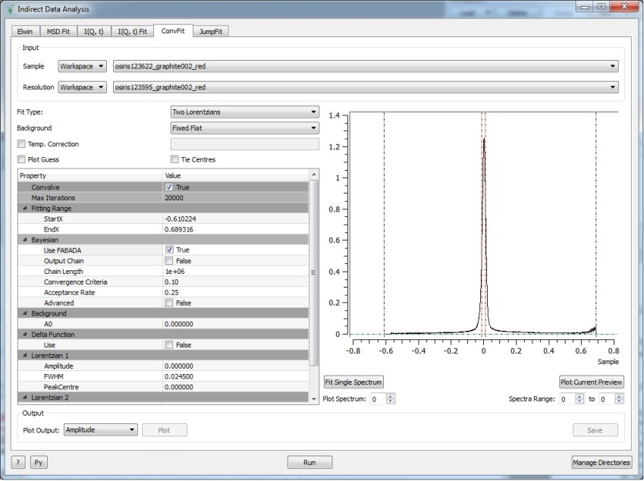
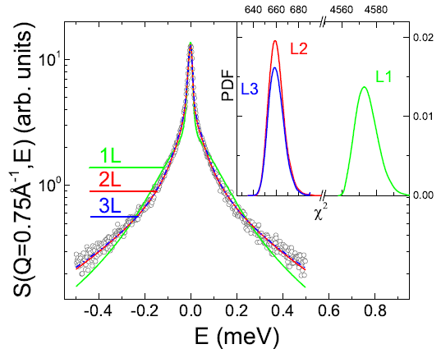
Molecular Spectroscopy Group : Work in Progress
Bayesian tool (FABADA) to explore χ² landscape
Simulations: Interfaces and Algorithms
abINS Algorithm for INS
DOS interface
nMoldyn interface
FABADA in Mantid ongoing …
MD fitting
Sequential fitting
Simulated annealing
Algorithms/ interfaces ongoing ..
High-throughput QENS :
IndirectQuickRun
IndirectSampleChanger
Data Corrections:
Paalman Pings

Slide 5
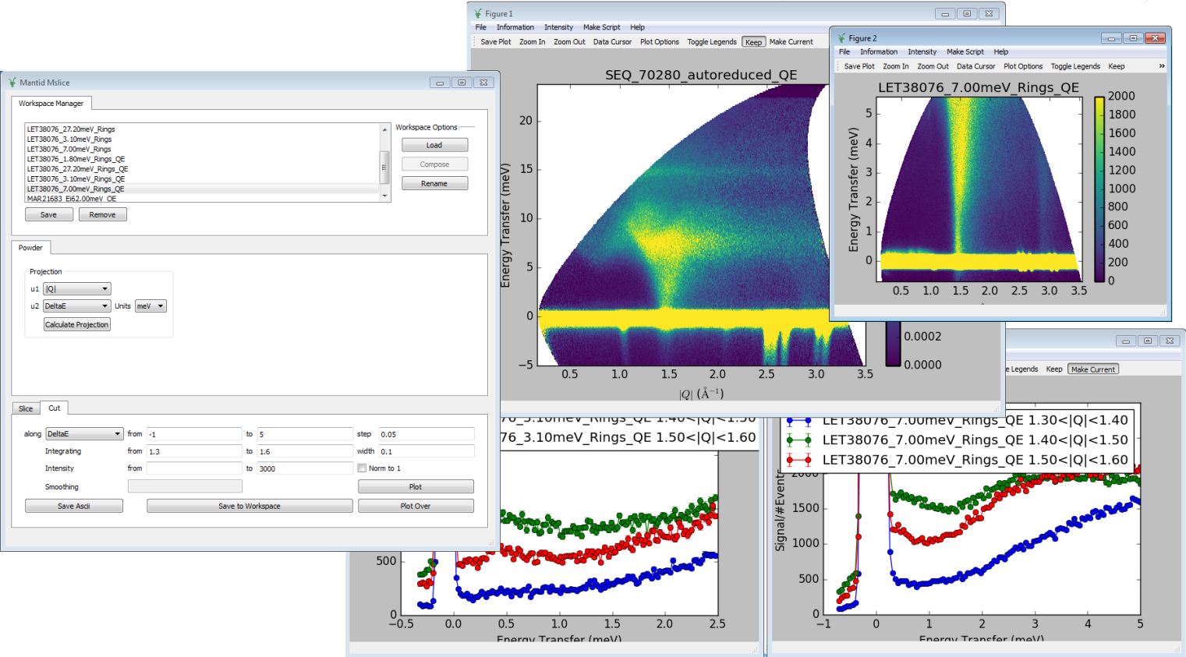
Inelastic : direct geometry
Replacement for matlab program used for quick look at data.
Uses Mantid Framework, but not MantidPlot (standalone PyQT GUI)
Now mostly a GUI, but a CLI also planned.
A lot of progress made by a summer student, but has since stalled.
In use on instruments for powder data.

Slide 6
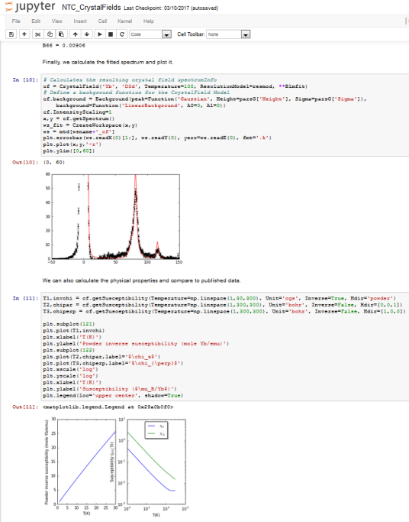
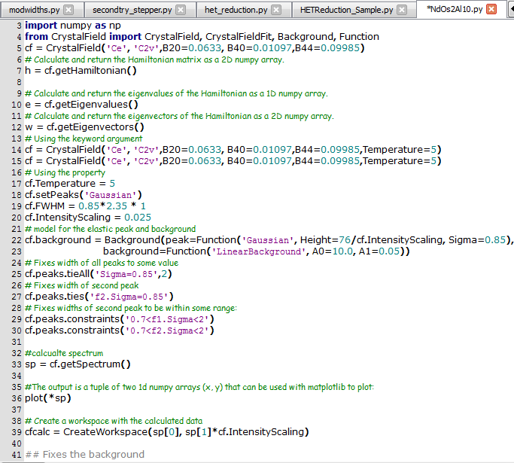
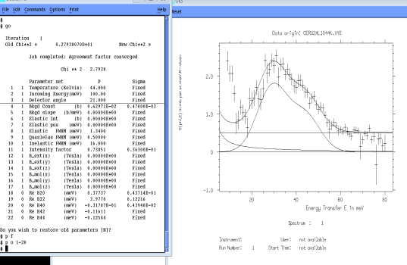
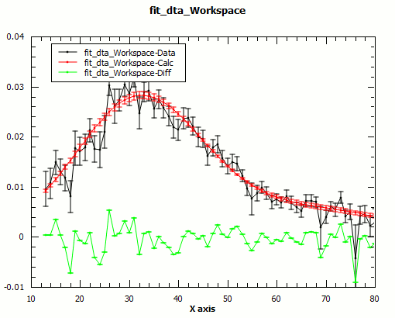
Crystal fields
Port of old FOCUS code (Fortran/VMS)
Still in progress (90% complete)
In use in user expt / training course
See talk tomorrow

Slide 7
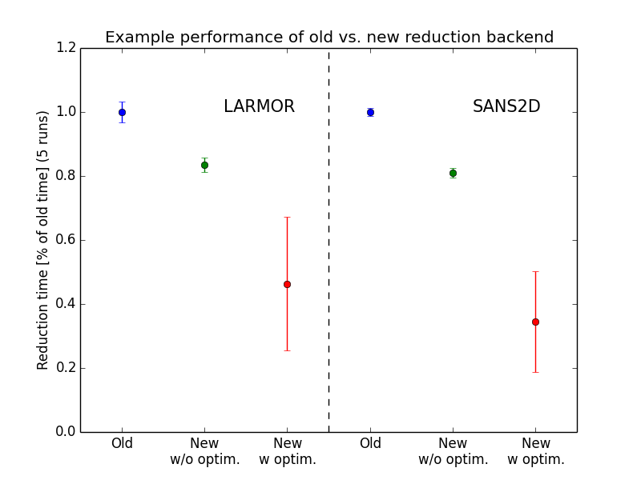
SANS
New, more performant reducer backend
NXcanSAS integration (first readers and writers of this format)
Handling of data which has been collected past the end of a frame
Support for event-based monitors which allowed users from Imperial College to perform transmission slices
Support for added multi-period event-based files.
IDF in reducer is dynamic and is based on the loaded data.
Processing of LOQ M4 in the SANS reduction was added

Slide 8
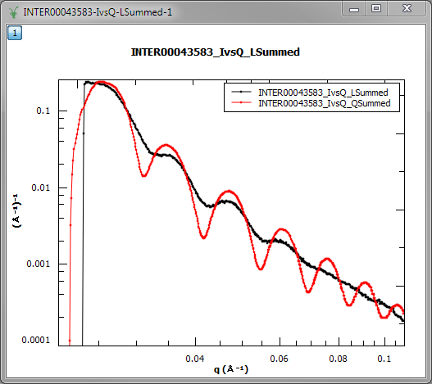
Reflectometry
Harmonisation of interfaces
New algorithm versions for
ReflectometryReductionOne, CreateTransmissionWorkspace
ReflectometryReductionAuto, CrateTransmissionWorkspaceAuto, SpecularReflectionPositionCorrect
Summation in Q extension for reduction algorithms
Improved stability
Event slicing (including slicing based on logs)

Slide 9
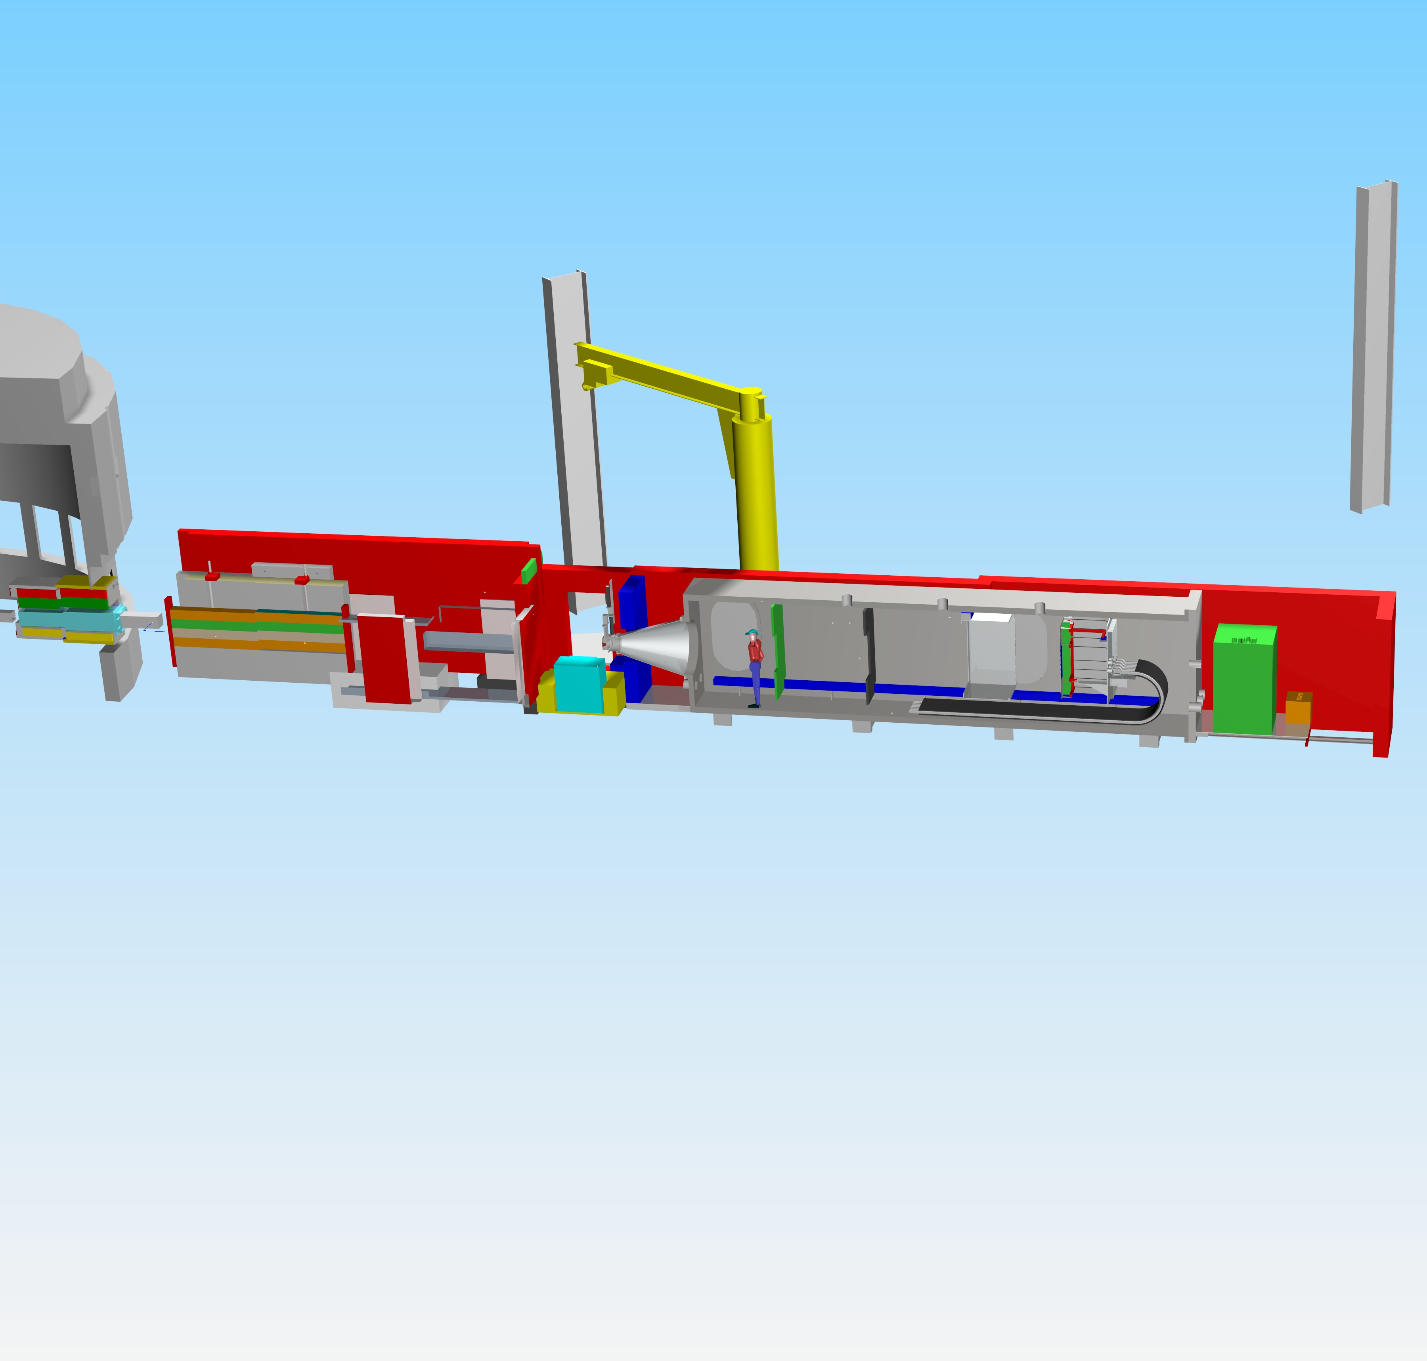
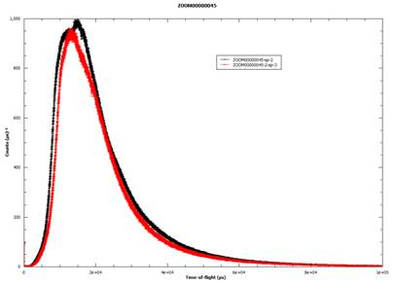
New instrument : ZOOM
At the moment, rudimentary analysis
Will use SANS (need to improve performance, underway)
Polarisation : should be OK.

Slide 10
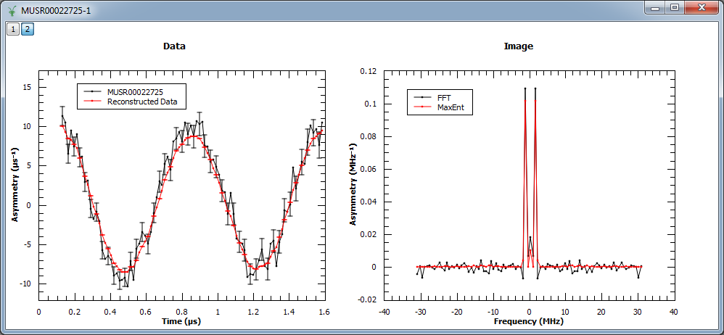
Muons - update
New Maximum Entropy reconstruction algorithm, where data and model related by a 1D Fourier transform
Support for calculating asymmetries and phases from a reference dataset
Support for multi-dataset fitting added to the MuonAnalysis interface
Better support for loading of Riken ARGUS instrument data
Auto shift property added to FFT to enable automatic phase correction

Slide 11
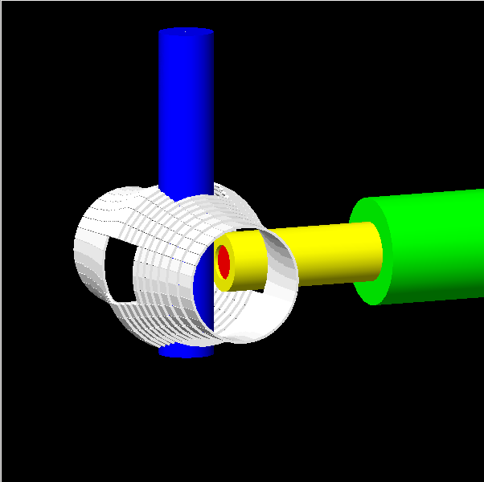
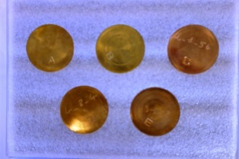
Future Plans - ISIS Muons
Super-MuSR
Planned upgrade of MuSR instrument:
~1000 detectors
~1,000M events/hr
Optimised for communities incl. Magnetism, Superconductivity, Batteries
Frequency domain analysis GUI; simultaneous fitting and extended function library essential
Negative muon experiments for elemental analysis
Rapidly growing area exploiting capability of RIKEN-RAL
Requires software for (at least):
Data loader
Background Subtraction
Automatic peak finding/assignment
Absorption corrections
…
Bronze Standards
Sn
Cu
As

Slide 12
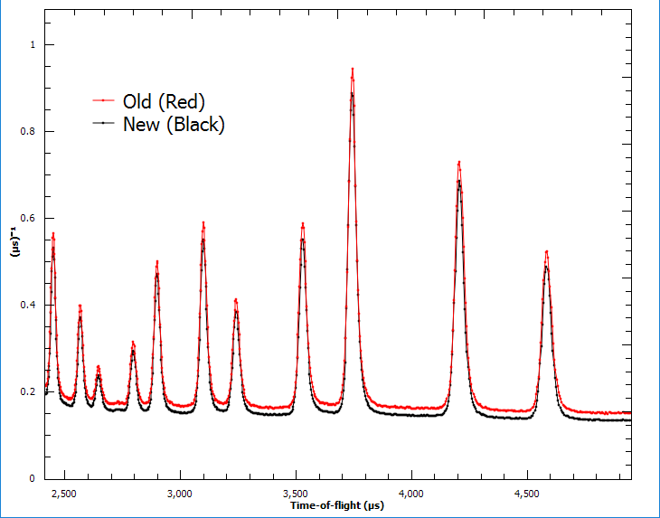
Powder Diffraction
Work on replacing existing incompatible scripts with a new set of scripts that:
Harmonise the technique whilst catering to each instrument’s unique requirements.
Allow new features for one instrument to be implemented on another easily.
For example multiple scattering corrections which has been added to the new scripts.
Come with clear documentation, examples and a tutorial.
Give clear error messages explaining what went wrong and how to resolve this.
Deployment in progress on three instruments with plans to port another instrument in the coming weeks.

Slide 13
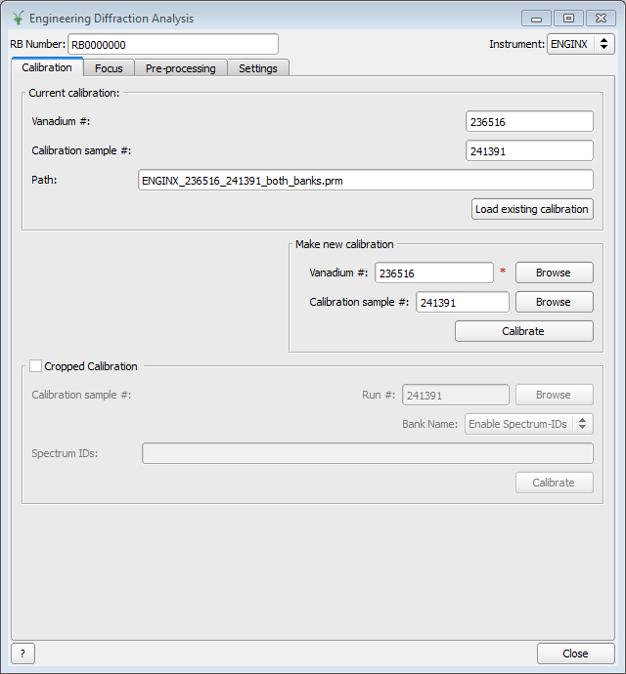
Engineering diffraction
Support of new functionality in the Engineering diffraction GUI including:
Multi-run processing
Basic support for event mode
Cropped and texture advanced options
Support for file formats: GSAS, OpenGenie, XYE format
New algorithm that call the GSAS-II software to refine lattice parameters
Updates added for masking, normalize by proton charge in Engin-X algs

Slide 14
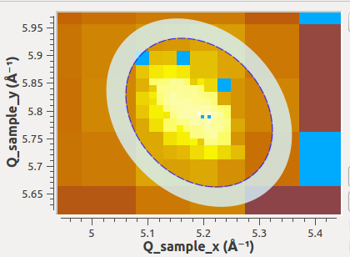
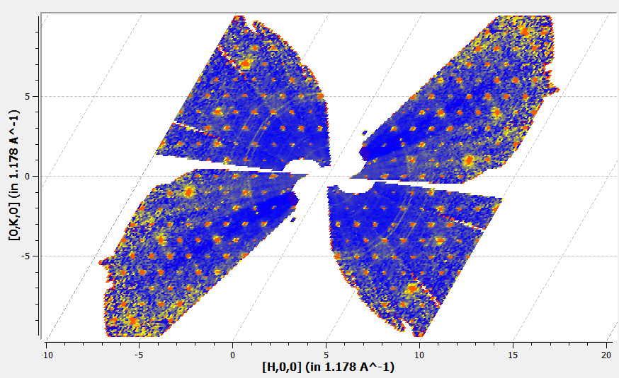
SliceViewer improvements
Single Crystal Diffraction
Various alignment tools (from instrument view) : easy angles calc, “super” inst.
Integration by steps “a la Racer”
elliptical and mix-mode peaks
Non-orthogonal display

Slide 15
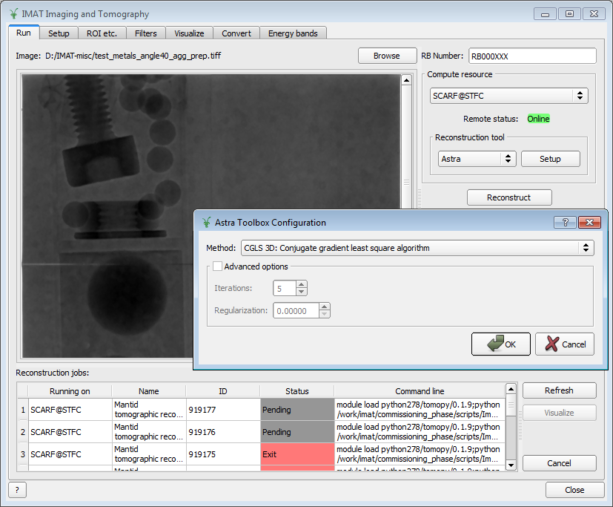
Neutron Imaging
New tomography reconstruction interface:
Running of 3rd party tomographic reconstruction software locally and remotely (SCARF)
Setting up pre-processing steps and filters
Handle the rotation of images
Visualize sequence of stacks of images and selecting regions of interest and regions for normalization
Support saving of images in FITS format

Slide 16
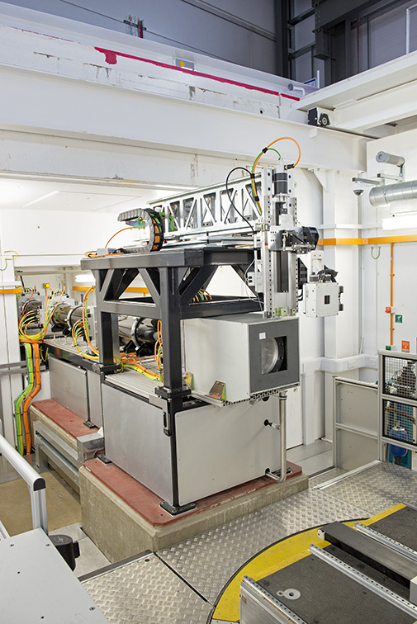
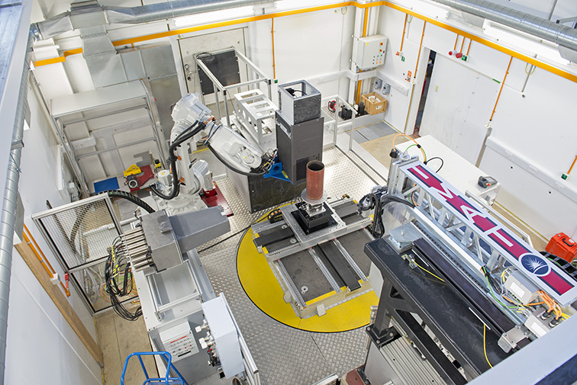
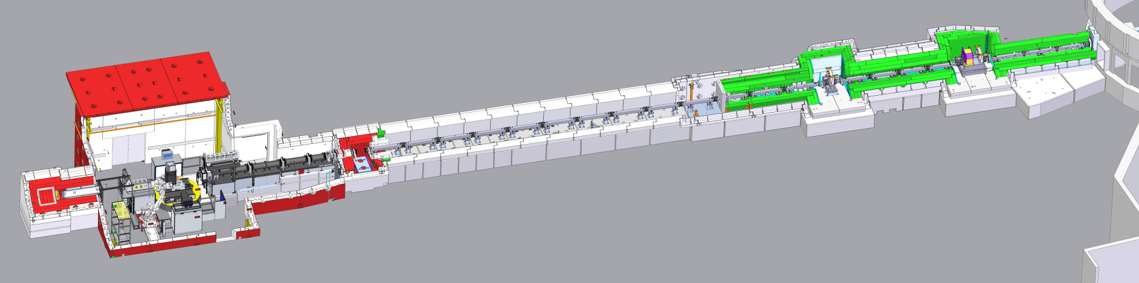
IMAT: Imaging and MATerials science
camera
200-element prototype detector

Slide 17
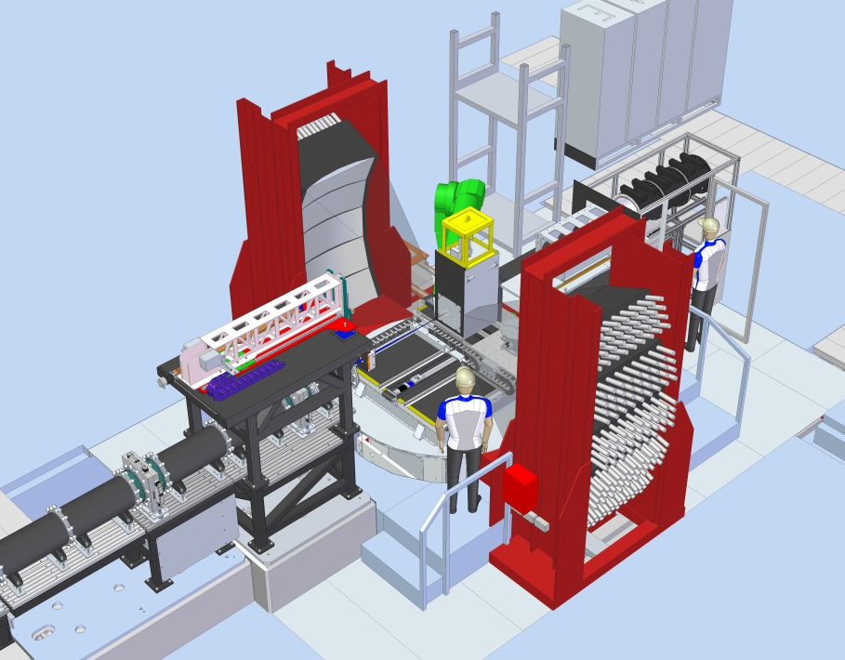
IMAT: completing the instrument (2018)
Installation of IMAT 90-degree diffraction detector arrays
Analysis of of structural and engineering materials
Residual strains
Thermo-mechanical materials testing (loading rigs)
Phase transitions
(some) Texture analysis
Combined Imaging + Diffraction: interpretation of energy-dispersive imaging data
Will also need Bragg edge fitting
at some point
Wavelength Shifting (WLS) fibres absorb and re emit light
WLS fibre option: ~ x 20 less fibres than for fibre-coupled arrays
Allows use of cost effective Multi-Anode PMTs
Enables reduction in cabling and HT

